Slide 1
Continuous Migration Support for Domain-Specific Languages
Daniel Balasubramanian, Tihamer Levendovszky, Anantha Narayanan, Gabor Karsai

Slide 2
Outline
Motivation
Model evolution
Advanced rules
Implementation
Summary
Conclusion

Slide 3
Motivation
Domain-Specific Languages
  Understandability for domain expert
  Support for code generation
  Generative technique
Metamodeling
  Flexibility
  Usability
Challenge – industrial applications
  Metamodels change due to better understanding, domain evolution, etc.
  Treatment of legacy models and…

Slide 4
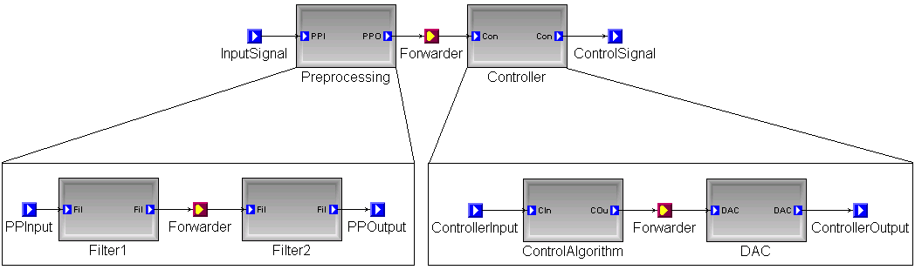
Example hierarchical SF

Slide 5
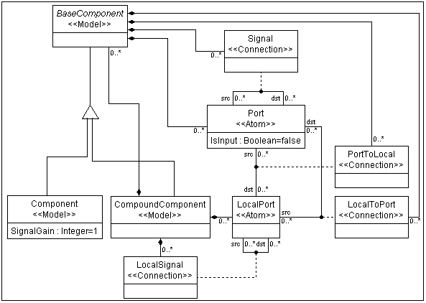
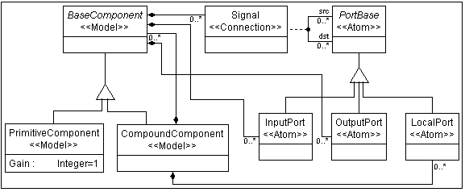
Evolving Legacy Models
Continuous, step-by-step evolution
MCL Rules
Original metamodel
Evolved metamodel
Notes:
Renaming
Inheritance hierarchy reorganization (connections are scattered)
Adding new concepts: input and output ports

Slide 6
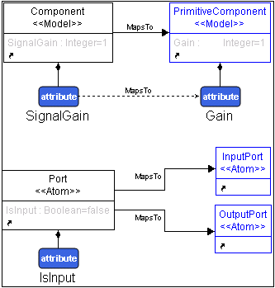
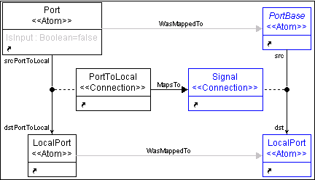
Sample MCL Rules
return (Port.IsInput());
return !(Port.IsInput());

Slide 7
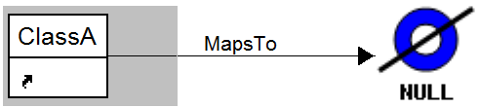
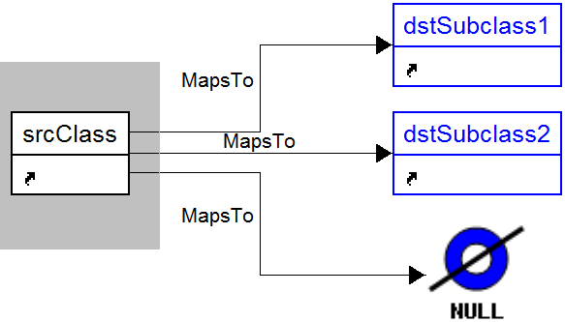
Deleting elements

Slide 8
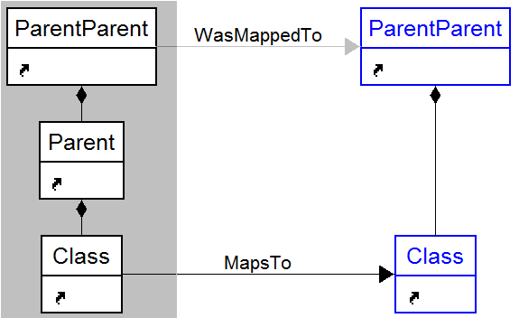
Changing containment hierarchy

Slide 9
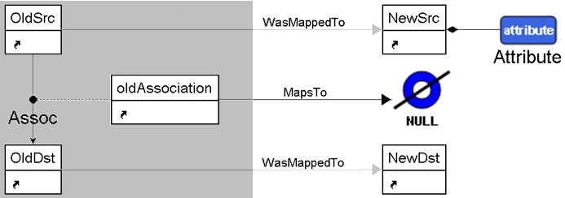
Replace association with attribute

Slide 10
Implementation
Depth-first search on the input model
Maintaining the correspondence
Delayed evaluation with a queue

Slide 11
Summary
Model 1
Original metamodel
Model 2
Model 3
Change Description (MCL)
Evolved Model 1
Evolved metamodel
Evolved Model 2
Evolved Model 3
Automatic migration

Slide 12
Conclusions
A step-by-step evolution concept
Using a DSML for specifying migrations
  Attach original and updated meta-models
  Define correspondences only between elements that have changed
  More efficient than the general transformation
Automatic migration of legacy models

